Slide 1
How does a carrier pigeon work

Slide 2
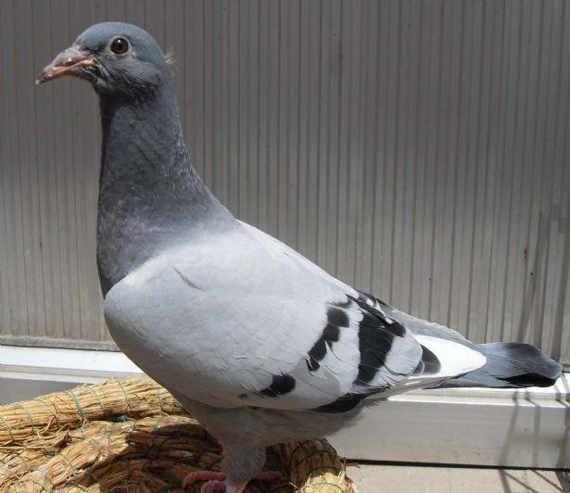
What is a carrier pigeon?
A carrier pigeon is a pigeon that can send letters from one person to another.
In New Concept English 2 Lesson5 No Wrong Numbers,Mr.Scott has two garages and he can send letters between them by pigeons.But how does the pigeons flies from one to the other?

Slide 3

Good sense of smell?
Some people thinks that pigeons find their way by their smelling.But it might be too ridiculous.If it is raining,the smell would change.
So,how pigeons find their way home?

Slide 4
Training
To make pigeons into carrier pigeons,everything starts from training.First,people will let them knowing home and its surroundings.People feed them.They drink there and etc.
So far,the pigeons have a home in their own GPS system.Next,is how to active them.

Slide 5
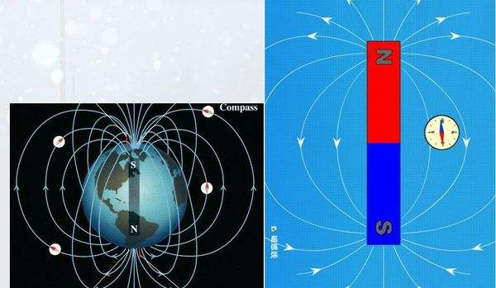
Earth's magnetic field
To know how pigeons lead their own way,we need to know the earth's magnetic field.What is magnetic field?We all know that the
earth has North and south
poles.And magnet has them
too.A pigeon has a compass
in its head,compasses can
point south and north,a pigeon can do it too.

Slide 6
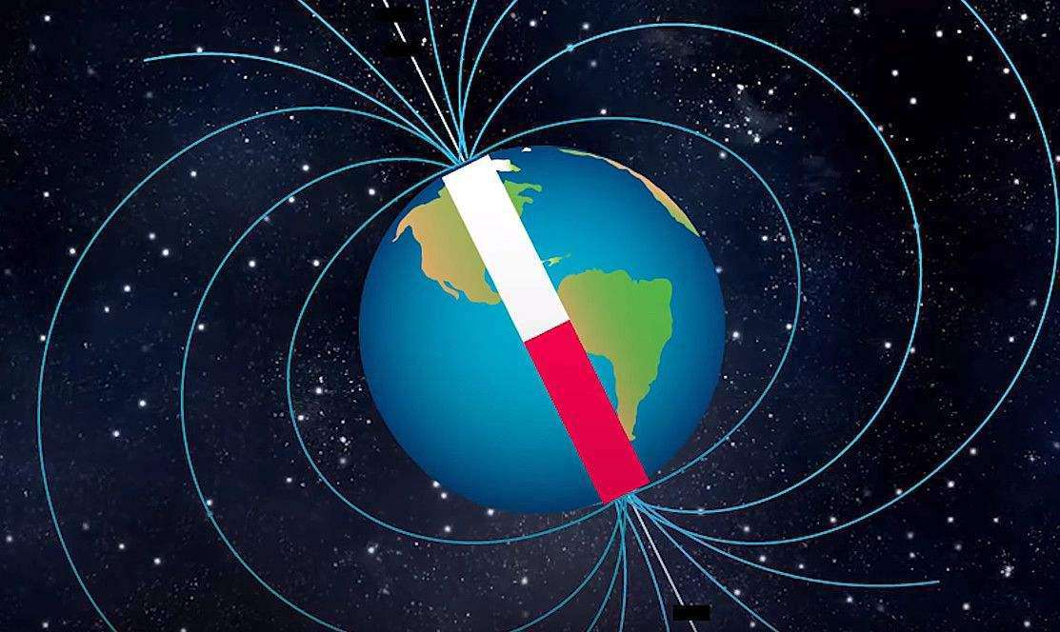
A crystal cell in pigeon's beak
There is a crystal cell in pigeon's beak is just like a compass.It can find out where is north and south.By detecting the strength of the magnetic force.Pigeons can find their way home.
Here,the magetic
is strong
But here,the magetic
is weak

Slide 7
Sun position
There is another way for pigeons find their ways.The sun always rises in the east and fall in the west.The pigeons can detecting ways by the sun.

Slide 8
More ways
There are still a lots of ways for pigeons to find their home.Such as Ionosphere magnetic navigation,Genetic navigation,Intelligence navigation,Memory navigation and so on.There're lots of ways of pigeons finding their ways for us to find out.

Slide 9
Thank you!

